Slide 1

Textual Echoes of Distress: Uncovering and Analysing Suicidal Discourse on Mental Health Subreddits
Arju Yadav MSc. Big Data Science

Slide 2


Who do you think is having suicidal thoughts?

Slide 3
Answer: It could be either one

Slide 4
Mental illness has No Face

Slide 5
Then how do we identify the potential individuals having suicidal thoughts?

Slide 6
Which one do you think is talking about suicide?
I feel like everyone has given up on me, I don’t want to live anymore.
I haven’t slept for 2 days. Then slept for two days straight and feel so weird.

Slide 7
Which one do you think is talking about suicide?
I feel like everyone has given up on me, I don’t want to live anymore.
I haven’t slept for 2 days. Then slept for two days straight and feel so weird.

Slide 8
Personal narratives can help identify people having suicidal thoughts.

Slide 9

Reddit Data to identify and analyse ‘suicidal’ content

Slide 10
Methodology
Data Collection:
suicide dataset from Hugging Face Platform
Pushshift Reddit API
Datasets: suicide_detection dataset, reddit_dataset (Year 2016-2022)

Slide 11
Reddit Data collected for Analysis
Popular Subreddits | Total Posts after processing (365,419)
mentalillness | 36,616
depression | 124,269
Anxiety | 157,786
bipolar | 35,273
schizophrenia | 11,475
Subreddits and Total Posts in reddit_dataset

Slide 12
Methodology
Data Collection: Pushshift Reddit API, Hugging Face Platform
Datasets: reddit_dataset (Year 2016-2022), suicide_detection
Detecting posts with suicidal content: Sentence Transformer Finetuned Model

Slide 13
Do the Longer narratives about mental illness have more Suicidal Content?

Slide 14
Methodology
Dataset: divided reddit_dataset (Year 2016-2022) based on post length. (small posts <=280 characters)
Detecting posts with suicidal content: Sentence Transformer Finetuned Model
Sentiment Analysis: VADER
N-gram Analysis: CountVectorizer

Slide 15
Longer narratives have more ‘Suicidal Content’
Percentage of Suicidal Posts
Small Posts (<=280 characters) 23.137%
Longer Posts (>280 characters) 57.490%
More than 50 percent of long posts in subreddits related to mental illness are having suicidal content.

Slide 16
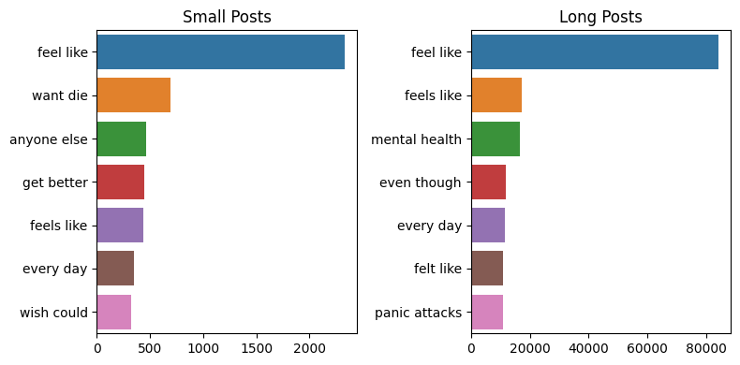
Frequent Bigrams
Small suicidal posts have high frequency of both negative bigrams like ‘want die’ and somewhat positive one like ‘get better’ and ‘wish could’ while Long posts have bigrams more related to feelings and words like ‘panic attacks’

Slide 17
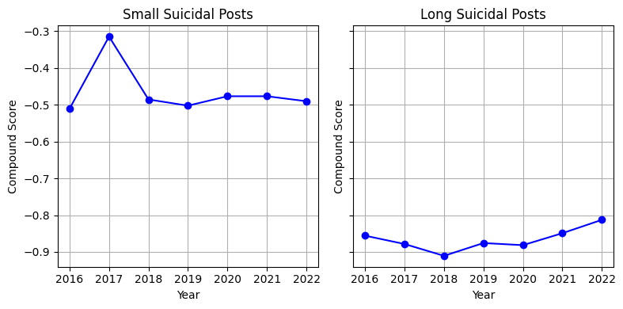
More negative sentiment in longer posts over the years

Slide 18
Are posts related to certain disorders having more suicidal content?

Slide 19
Most Common Mental Disorders and their symptoms
Mental Disorder | Symptoms include (but not limited to)
Depressive Disorder (Depression) | Low mood or sadness, feelings of hopelessness or pessimism, feelings of irritability, frustration, or restlessness
Anxiety Disorder | Restlessness, a sense of dread or fear, difficulty concentrating, Difficulty controlling feelings of worry
Bipolar Disorder | Episodes of mania (feeling overjoyed) and depression (feeling extremely distressed) often last for several days or longer
Schizophrenia | Hallucinations, confused thinking and speech, taking no interest in everyday social interactions

Slide 20
Methodology
Detecting posts with suicidal content: Sentence Transformer Finetuned Model
Label data discussing mental disorders: Semantic Search S-BERT
Sentiment Analysis: VADER
N-gram Analysis: CountVectorizer

Slide 21
Percent of posts having ‘Suicidal Content’
Percentage of Suicidal Posts
Depressive Disorder: 70.866%
Anxiety Disorder: 42.013%
Bipolar Disorder: 54.903%
Schizophrenia: 47.658%
More than 70% posts related to depressive disorder are having suicidal content.
More than 50% posts related to bipolar disorder have suicidal content

Slide 22
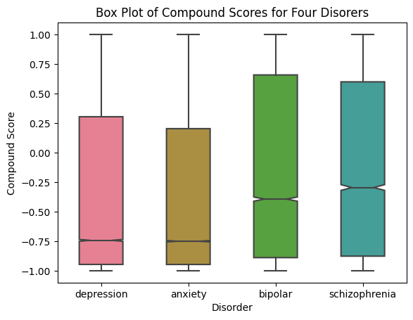
Sentiment Scores in each disorder
Depressive Disorder and Anxiety Disorder related posts have more negative sentiment.

Slide 23
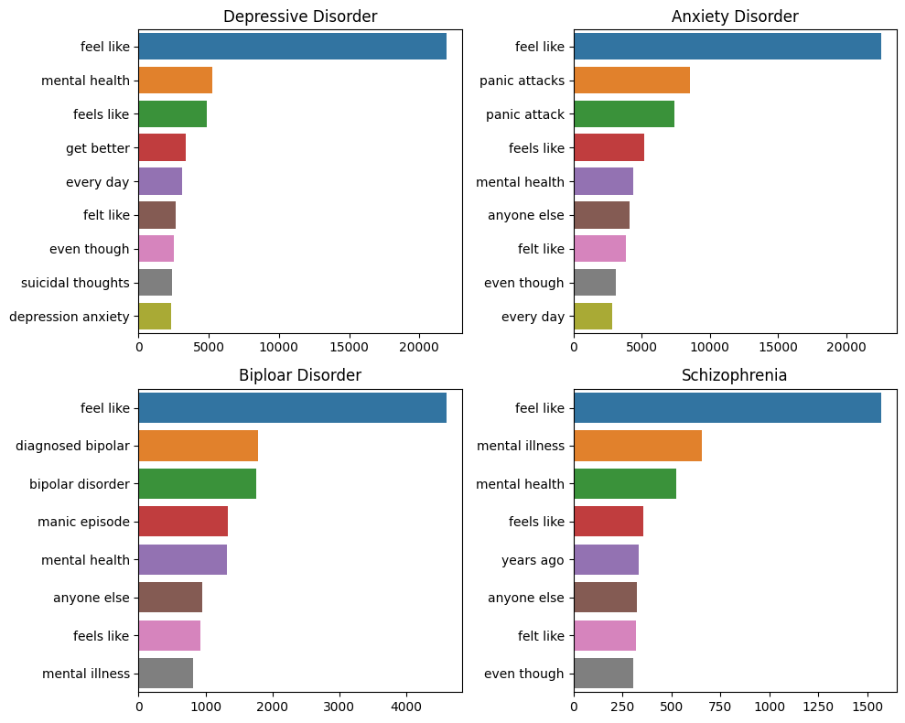
Bigrams of all four disorders

Slide 24
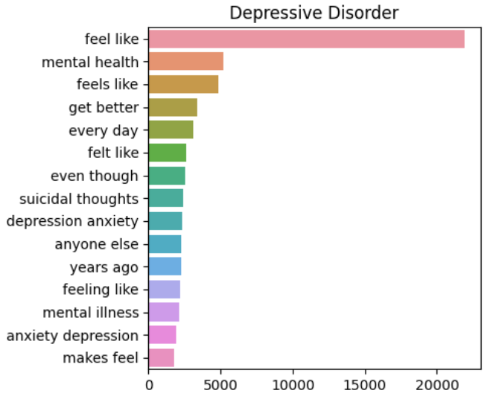
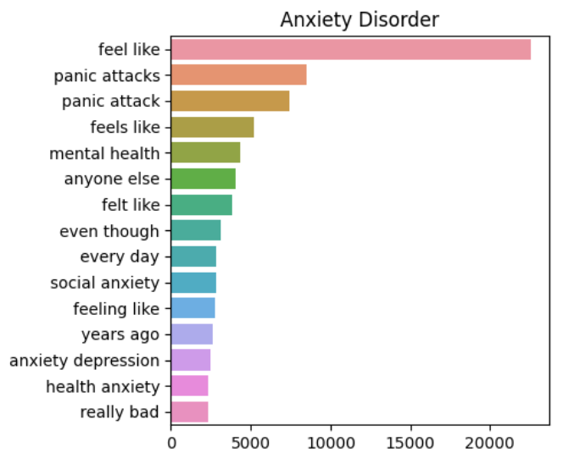
Comparing Bigrams of Depressive Disorder and Anxiety Disorder
Posts in Depressive disorder contain frequent bigram like ‘suicidal thoughts’ which suggest that this disorder have more suicidal content.
Even though anxiety disorder related posts have bigrams like ‘panic attack’, ‘social anxiety’ which shows more negative words but less ‘suicidal’ content.

Slide 25
Conclusion
Longer narratives related to mental illness have more suicidal content.
Narratives discussing mental illness like depressive disorder and bipolar disorder have more suicidal content.

Slide 26
Future Work
Extend to other disorder like eating disorder, attention deficit disorder etc.
Find more indicators of suicide and predict a suicide attempt.
Better intervention strategies.

